Slide 1
Group 4 - Sprint 4 Presentation
Group Members: James Campbell, Trevor Nolan, David Thomas

Slide 2
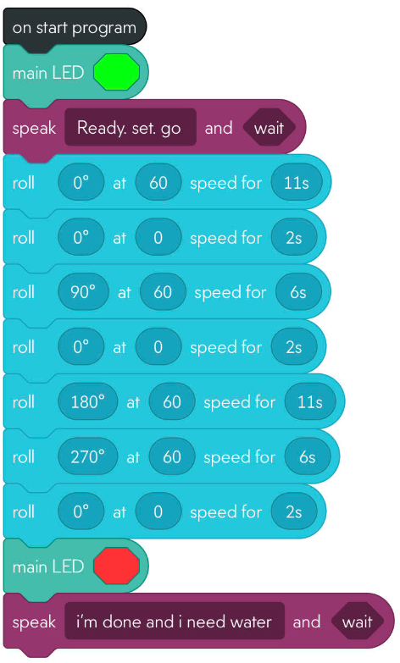
Sprint 1 - Endurance
Group responsibilities:
James: Editing the SDD
David: Made Github and assisted in editing the SDD
Trevor: Created the code.
Instructions:
Turn light color green
Say “ready set go”
Roll forward 22ft
Turn right 90 degrees
Roll forward 11’8”
Turn right 90 degrees
Roll forward 22ft
Turn right 90 degrees
Roll forward 11’8”
Challenges: Since this is the first sprint, there were a lot of difficulties in making the code. There was a total of 14 code tests in Sprint 1 before being able to perfect the code.
This initial sprint helped teach the basics of coding that would assist in making future codes faster and efficiently.

Slide 3
Sprint 2 - Accuracy
Group responsibilities:
James: Editing the SDD
David: Made Github and assisted in editing the SDD
Trevor: Created the code.
Instructions:
Drive in a circle at a designated speed until the circle is complete
Drive in a circle in the opposite direction at a designated speed until the circle is complete
Repeat this 5 times
Stop the program
Challenges: Unfortunately, a lot of personal commitments occupied a lot of our times. This made completing the Sprint difficult, but we persevered and successfully completed the sprint.
After struggling with the coding of sprint 1, the practice certainly helped as only 3 tests were needed before completion.

Slide 4
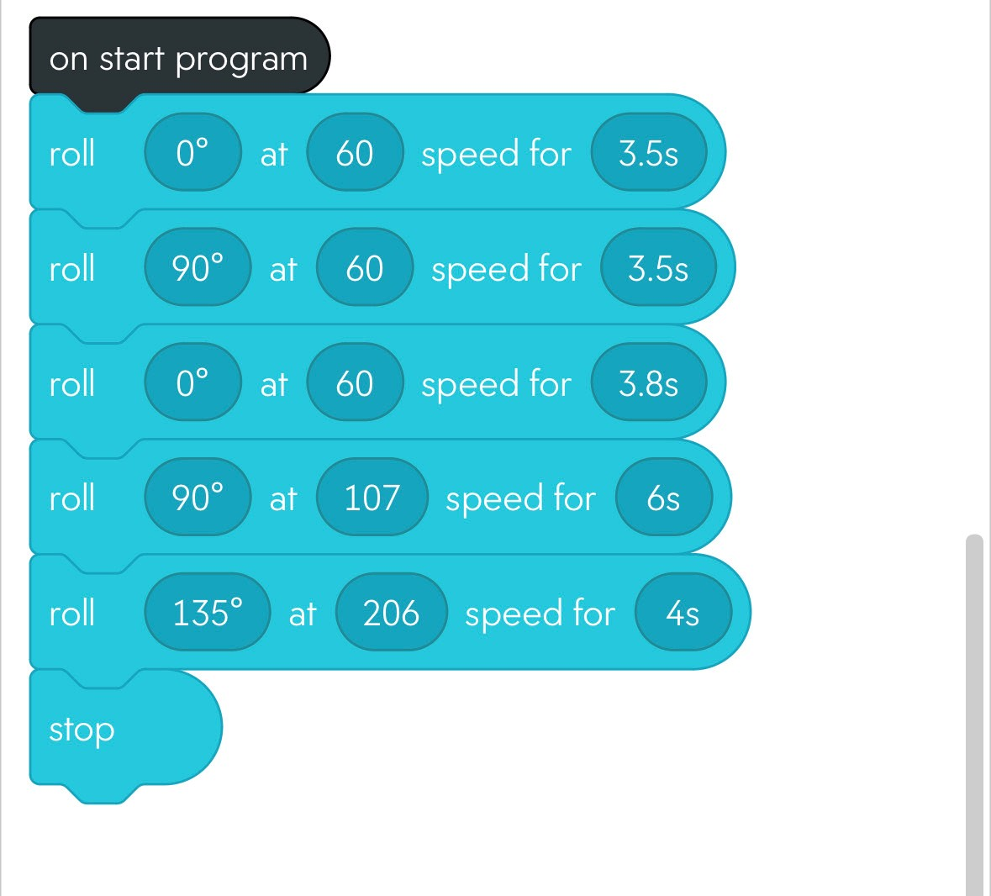
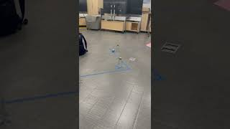
Sprint 3 - Agility
Instructions:
Travel forward 3’3’’
Turn right 90 degrees
Travel forward 3’4’’
Turn left 90 degrees
Travel forward 3’11’’
Turn right 90 degrees
Travel 7’3’’ at high speed
Turn right 120 degrees
Travel forward 10 ft at high speed
Group responsibilities:
James: Editing the SDD
David: Made Github and assisted in editing the SDD
Trevor: Created the code.
Challenges: After struggling with coding and communication, Sprint 3 thankfully went much smoother.
The number of coding tests went down as well, only 3 tests needed before perfecting the code.

